Slide 1

Social Media
and
Content Marketing
A Personal Project by
Zulfa Irbah

Slide 2

Naracha
Naranacha is a local footwear brand dedicated to crafting high-quality and stylish footwear for women with affordable price. The brand name itself exudes a sense of uniqueness and a touch of the exotic, evoking the image of vibrant oranges (naranjas) and the charm of something distinct and refreshing.

Slide 3
Marketing Strategy
Positioning
Segmentaion
Targeting
Young women (22-35) who are fashion-forward and budget-conscious.
Middle-aged women (35-50) who seek comfortable and stylish footwear at an affordable price.
Focus on specific regions or cities where there is a demand for affordable yet stylish footwear.
Women of different age of groups (teens, young adult, middle-aged, etc)
Regions in Indonesia where there is a lot of demand
Target those who prioritize style and comfort in their footwear choices
Highlight the affordability factor to position the brand as an accessible choice for consumers.
Use the local identity to make people feel like they belong and are proud of their own identity.

Slide 4
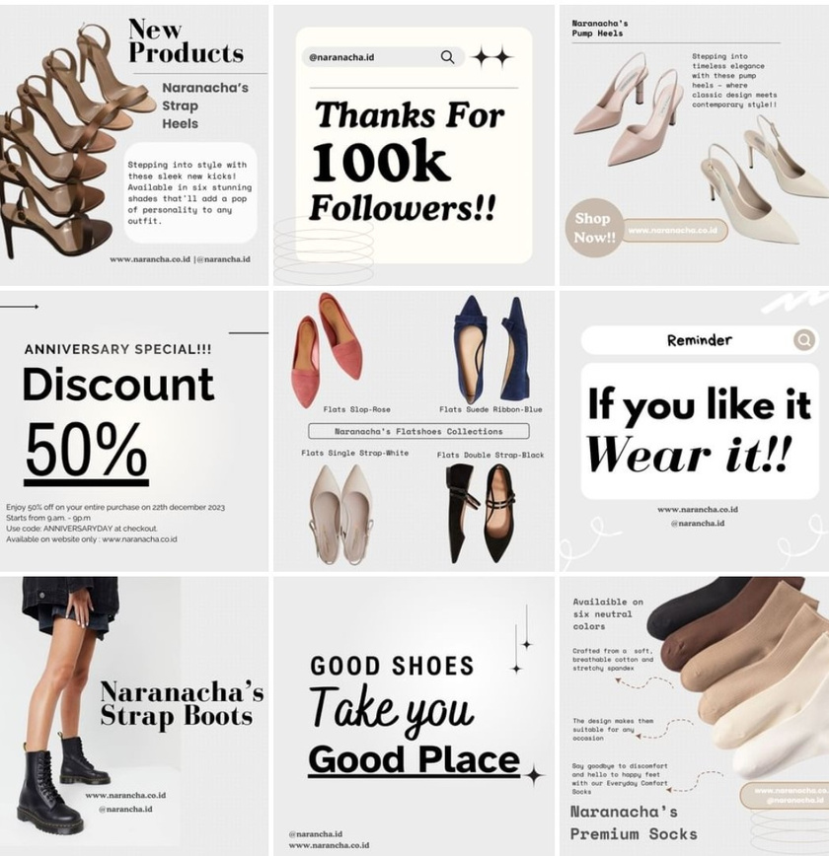
Social Media Content for Naranacha

Slide 5
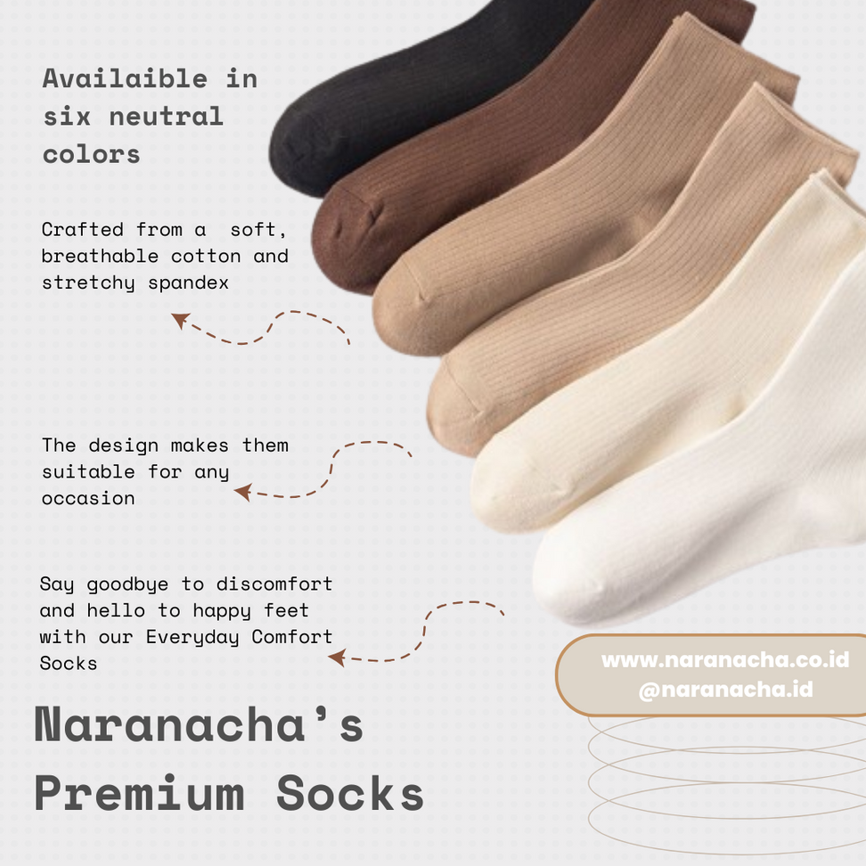
Adding text to photos can contribute to storytelling. It helps guide the viewer through a narrative, providing additional information or context to complement the visual elements.

Slide 6
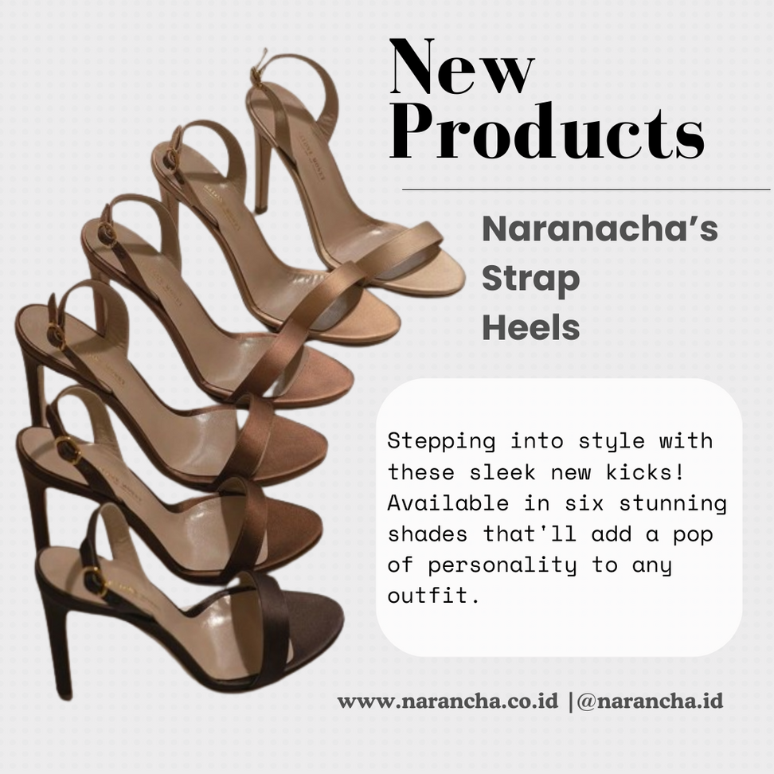
When introducing new products, it's crucial to give a short but complete description. This brief yet informative overview helps complement product photos, giving potential customers useful insights and details.

Slide 7
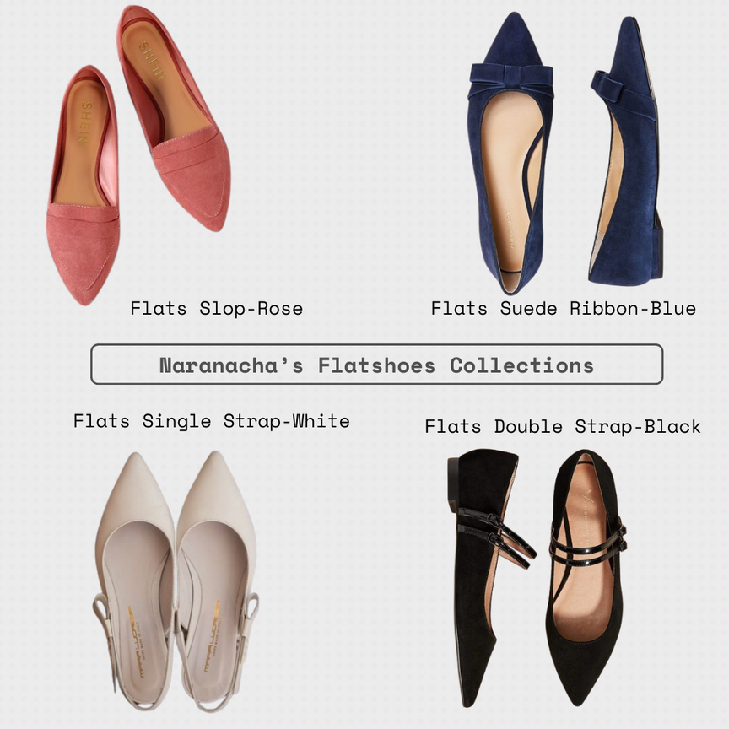
Posting a collection of flat shoes in one photo for marketing serves the purpose of showing off lots of styles and designs in a pretty way.
It's a quick way for customers to see all the choices available.

Slide 8

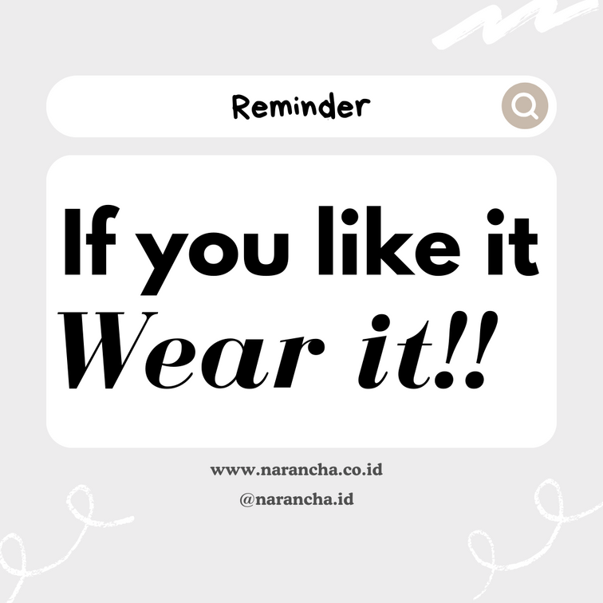
Posting some quotes related to products in marketing serves the purpose of connecting emotionally with customers and reinforcing brand messaging.

Slide 9
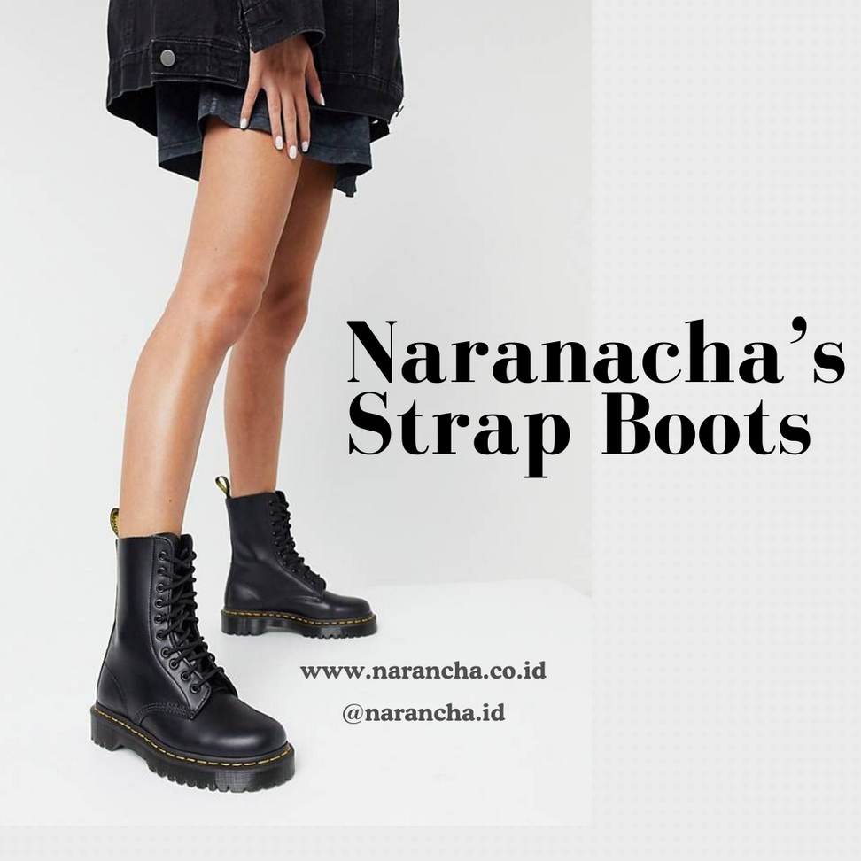
A post featuring only a product photo and website text serves a specific purpose. It aims to focus attention on the product itself and provide essential information about where to find more details or make a purchase.

Slide 10

By providing discounts on products during special event, it makes customers feel excited and in a hurry to buy. People like getting deals, especially during celebrations. This helps businesses get new customers, make current customers come back, and make people like the brand even more.

Slide 11
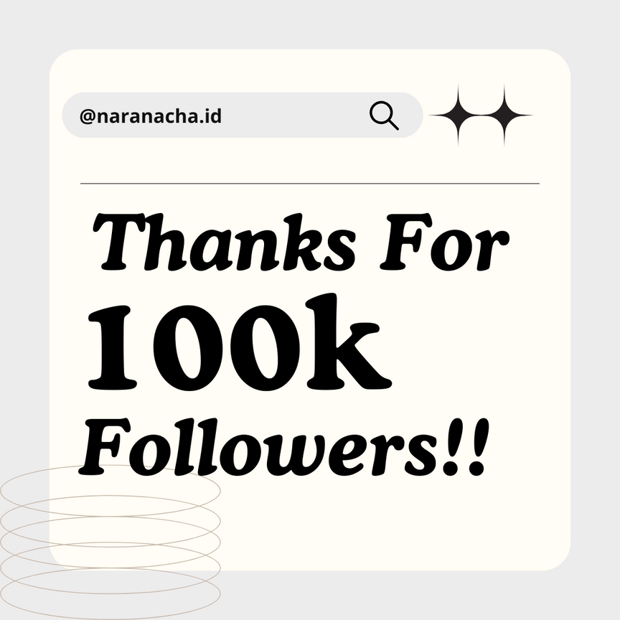
Saying thank you when an Instagram business reaches a certain number of followers in marketing serves to express gratitude and build a positive relationship with the audience. It acknowledges the support of the followers, making them feel valued and appreciated.

Slide 12
Aumsara Beeds
Aumsara Beads is a unique jewelry brand that specializes in handcrafted bracelets, necklaces, and rings made exclusively from carefully selected beads. The brand name itself blends the essence of spirituality (Aum) with the beauty of crafting (Sara), encapsulating a brand dedicated to creating meaningful and aesthetically pleasing jewelry pieces.

Slide 13
Marketing Strategy
Positioning
Segmentaion
Targeting
Female age around 15-40
- Fashion-conscious and appreciative of handmade items.
Value uniqueness and individuality.
Regularly purchase and wear jewelry.
Focusing on teens and young adult women (15-25 years old)
consumers who appreciate handmade, unique jewelry.
Emphasize the handcrafted nature of the jewelry, portraying it as wearable art that tells a story.
Utilize social media platforms (Instagram, Pinterest) to showcase the aesthetic appeal and spiritual significance of the jewelry.

Slide 14
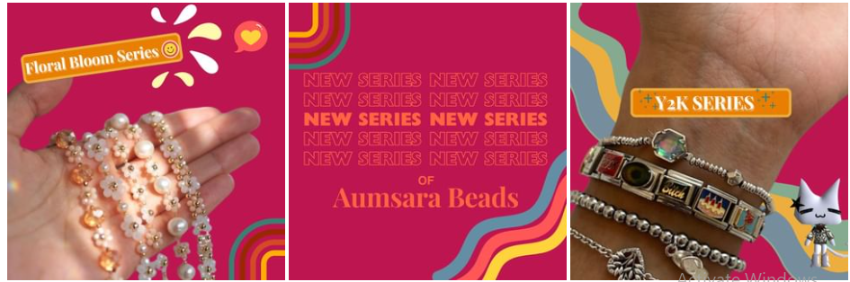
Social Media Content for Aumsara Beads

Slide 15
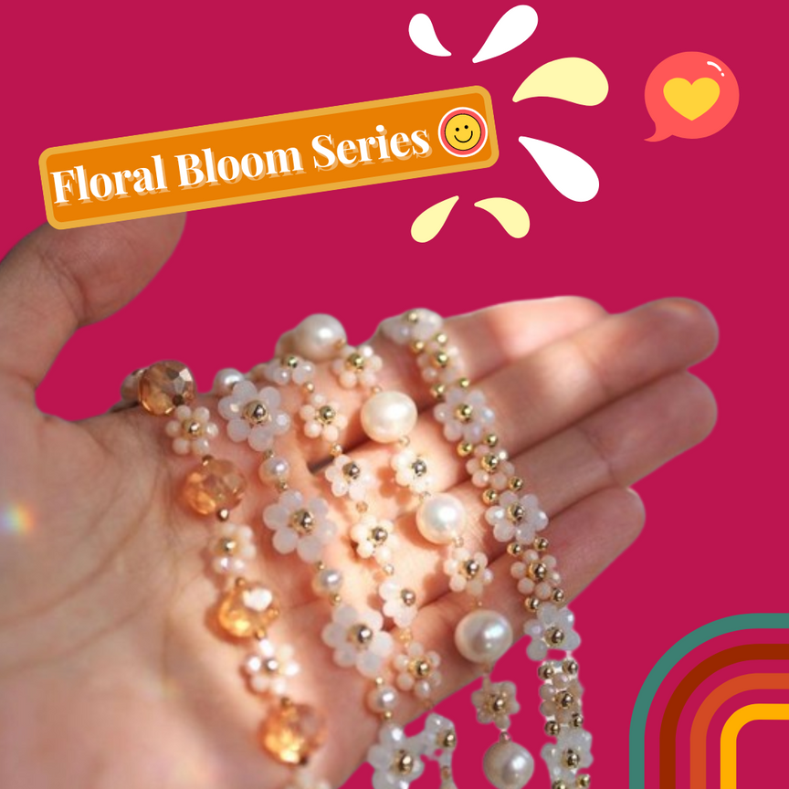
Bright colors such as pink are suitable for the background photo of beads products targeting the 15-25 age group, especially for bracelets, because they evoke a sense of youthful vibrancy and energy. These colors are visually appealing and align with the youthful and dynamic nature of the target demographic.

Slide 16
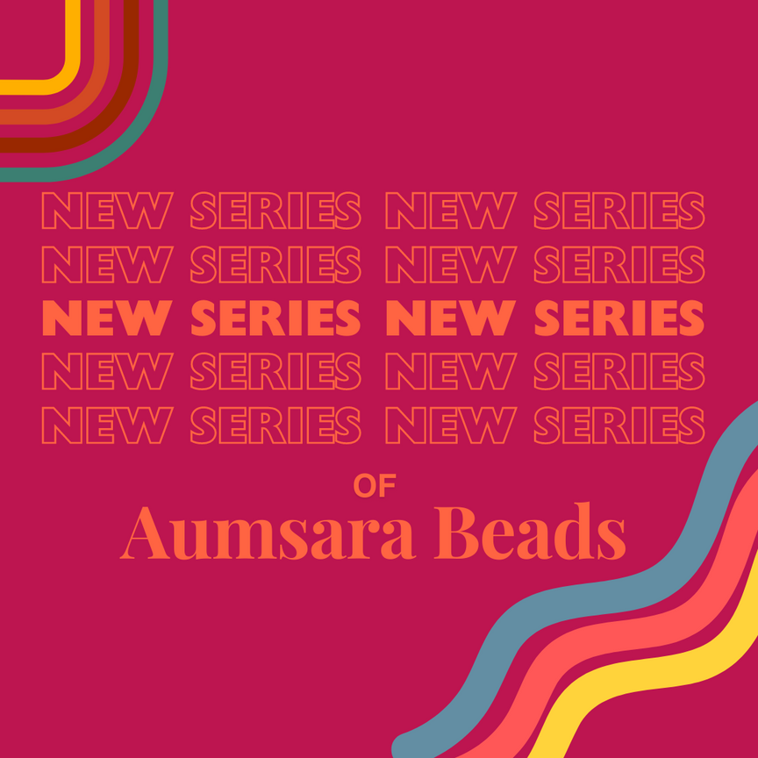
An Instagram post filled only with text for a new series of bracelet products serves to generate anticipation and engagement of the upcoming collection.

Slide 17
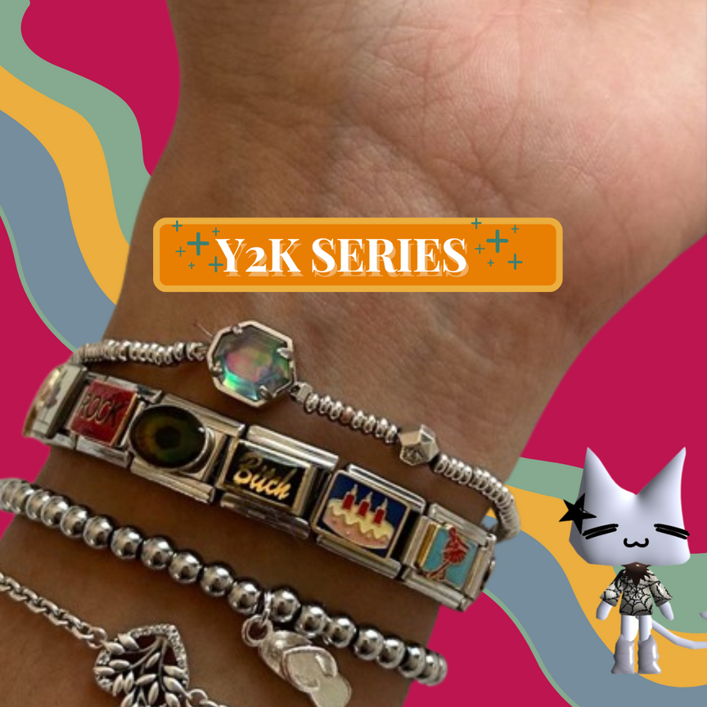
Photo’s element
Decorating a photo with various elements in a photo serves multiple purposes in marketing and presentation. Firstly, it helps emphasize the unique characteristics and features of each bracelet type.

Slide 18
Warmie++
Warmie++ is a food and beverage business known for making delicious meals, especially a variety of tasty noodle dishes. They're famous for their dedication to making food that's really good and trying out new ideas. Warmie++ creates a menu with lots of different choices to make sure everyone finds something they like. They focus on making high-quality food that people enjoy.

Slide 19
Marketing Strategy
Segmentaion
Targeting
Positioning
Teenagers (13-19), Young Adults (20-35), midle Age(35-59), old adults(≥60)
Male and Female
High-income individuals and Middle-income individuals
Urban area, suburban area
Health-Conscious Consumers, Food Enthusiasts, Convenience-Seekers
Targeting a demographic range from teenagers to middle-aged individuals,
appealing to both genders
focusing on affordability for middle to lower income brackets in urban areas
Aligning with the preferences of the busy, convenience-seeking customer.
"Warmie++ – Where Quality Meets Affordability."
It promises a diverse menu of delicious noodle dishes, ensuring that customers can embark on a flavorful journey without breaking the bank.

Slide 20
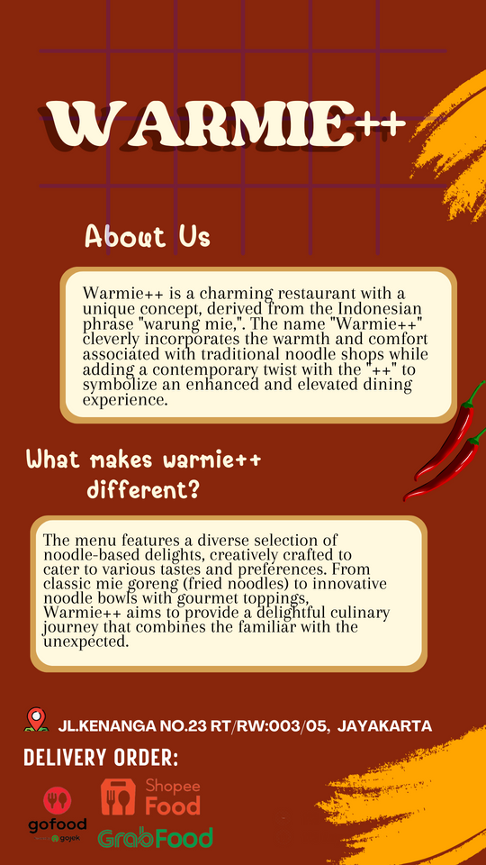
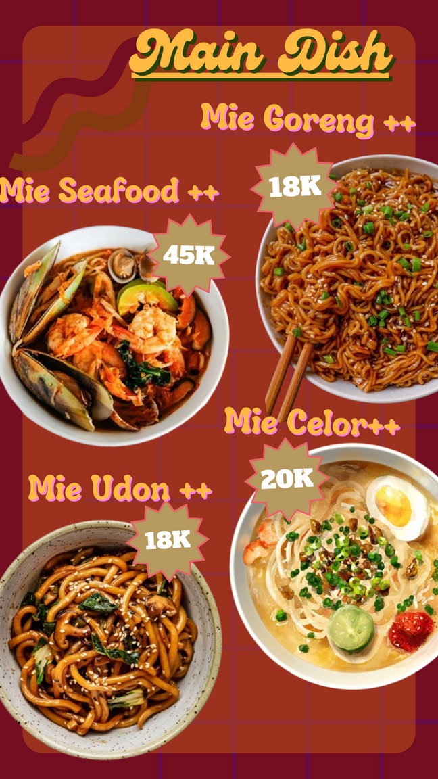
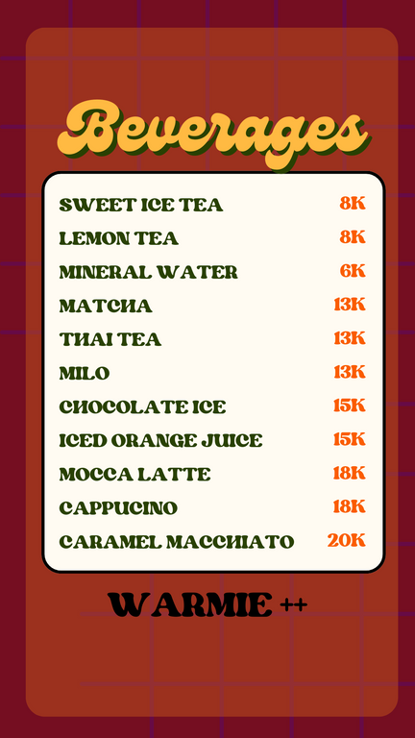
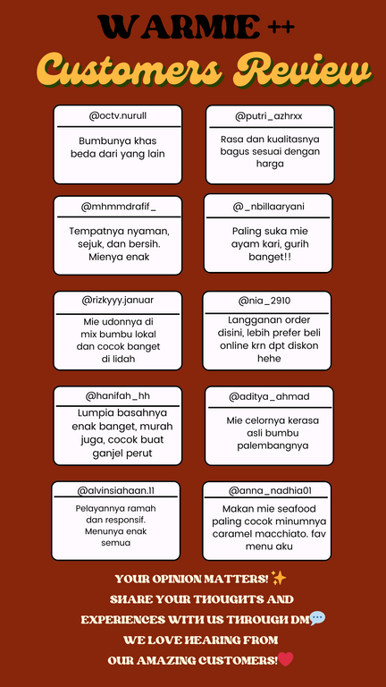
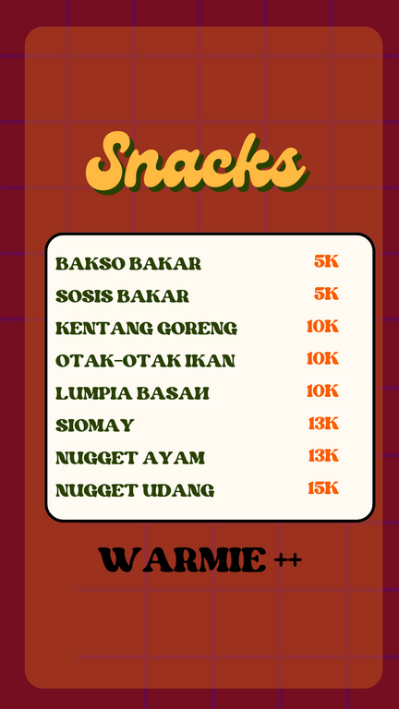
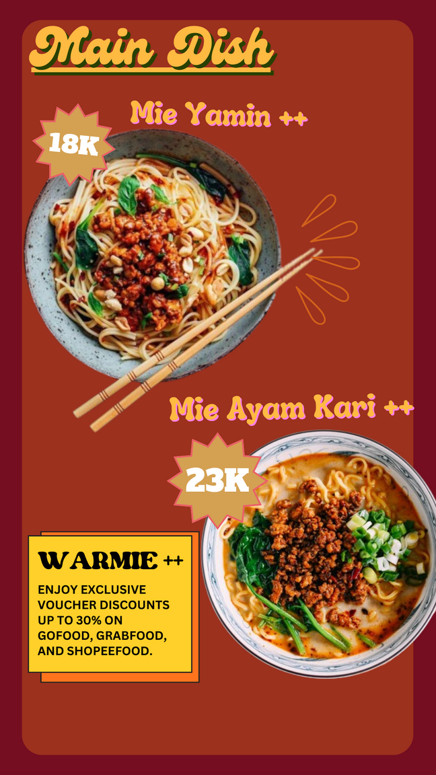
Story Contents for Warmie ++

Slide 21
Having clear and eye-catching photos of the main dishes on a restaurant's Instagram Stories is really important. Instagram is all about pictures, so having great images of the main menu items grabs people's attention and makes them hungry.

Slide 22
Snack and drink on Imenu list often keep it simple by just showing the product name and price without any pictures. This straightforward approach is intentional, designed to quickly grab attention in the fast-moving world of social media.

Slide 23
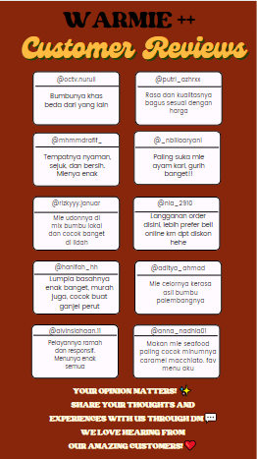
Sharing information about the restaurant and showcasing customer reviews on Instagram Stories is crucial for building trust and attracting new customers, it gives potential customers a glimpse into what to expect.

Slide 24
Thank You!!!

